Slide 1



Bob the Bunny
Teaches Programming
OEC 2016 – UOIT Entry

Slide 2

Problem Statement
The city of Waterloo has asked us to design an interactive tool for children aged 5-7 years old to learn the basics of programming.

Slide 3
Requirements
The program must have the following programming concepts communicated successfully:
- Variables
- Condition Statements
- For Loops and While Loops
- Subroutines
The tool is supposed to be targeted towards children and must have an appealing interface for the target group (children).

Slide 4
Our Product
Bob the Bunny is an interactive tool that teaches children the ages 5-7 how to program.
The tool is a fun game for children to play that teaches the basic fundamentals of programming with ease.
Throughout the game, the user will have to navigate a bunny through different challenges on a map.
The bunny will travel through portals, will change directions through arrows, and will travel to other levels all to demonstrate the basic programming logic.

Slide 5

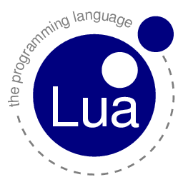



Tools Used
Language/ Technology Used | Image
Game Programming Language Framework
Image Editing Tool
Image Editing Tool
Version Control
ProgrammingLove2D.

Slide 6
Management Process
Our group decided to work using Extreme Programming (XP) as a management methodology to work on this project.
XP is an agile programming methodology that allows for constant review and redesign.
XP has a main programmer and a secondary observer that observes the programming and acts as a live debugger, checking for errors and offering suggestions.
The rest of the work was divided up amongst the other members to gather sounds, build artwork, and construct title animations.

Slide 7
Satisfying Requirements
For the four different requirements, we designed four unique features or obstacles in the game to engrain the programming concepts in a child.
We understood that a child aged 5-7 cannot understand basic algebra and many other concepts that are the foundation of programming.
The tool includes four unique obstacles in the map that help get these four core programming concepts across.

Slide 8
Using Variables

Slide 9
Conditional Statements

Slide 10
Loops

Slide 11
Subroutines

Slide 12
Demonstration

